Slide 1

Batch Normalization
Batch Norm at
test time
deeplearning.ai

Slide 2
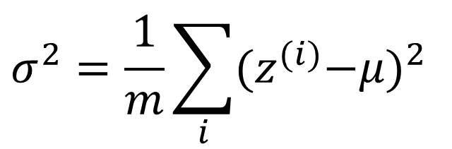
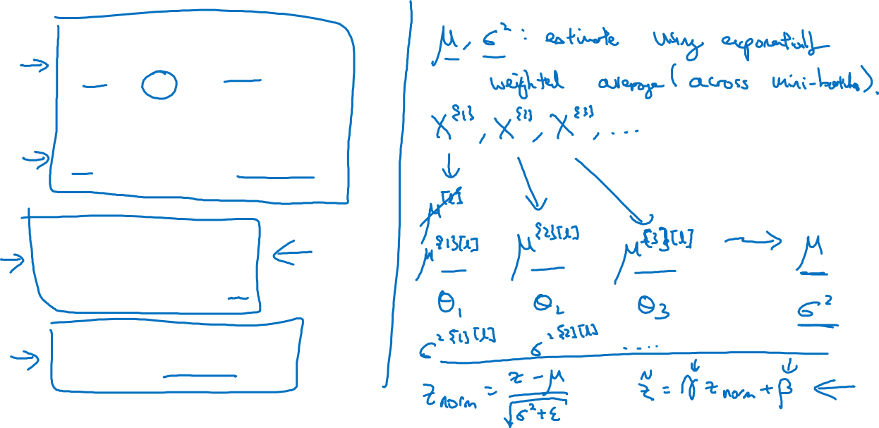
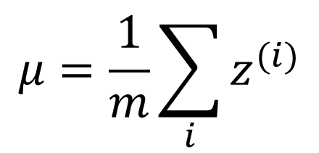
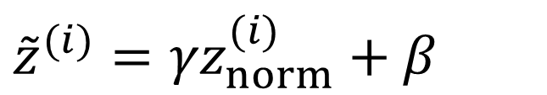
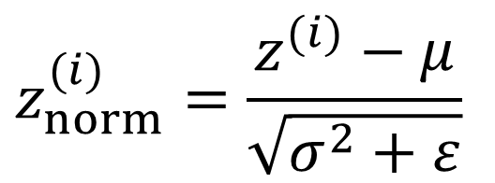
Batch Norm at test time
$$μ=\frac{1}{m}\sum_{i}{z^{(i)}}$$
$$σ^{2}=\frac{1}{m}\sum_{i}{{{(z}^{(i)}−μ)}^{2}}$$
$$z_{norm}^{(i)}=\frac{z^{(i)}−μ}{\sqrt{σ^{2}+ε}}$$
$${{\tilde{z}}^{(i)}=γz}_{norm}^{(i)}+β$$

